Slide 1
ATLAS PROJECT E-Learning Platform with Auto Evaluation

Slide 2



Greeting
Welcome Address
Good morning/afternoon everyone, and thank you for joining today's presentation on the Atlas Project.
Appreciation for Opportunity
Im grateful for the chance to share how Atlas is transforming assignment evaluation in e-learning environments.
Interaction Invitation
Please save your questions for the end. I'll be happy to address them, or connect with me afterward for further discussion.

Slide 3
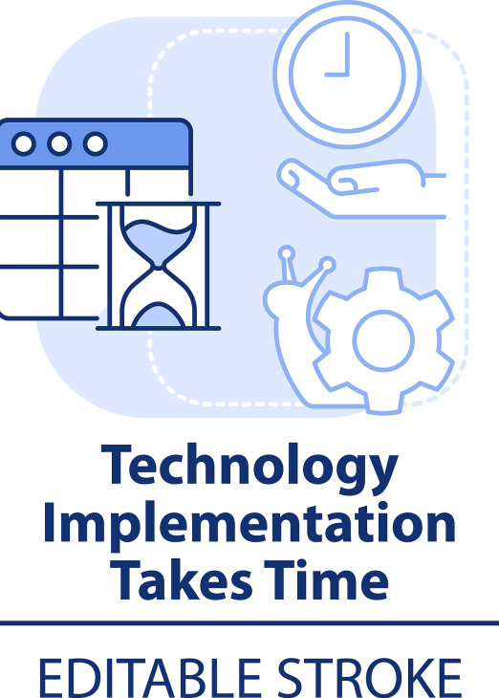
Problem Statement
Time-Consuming Manual Processes
Traditional grading takes hours of instructor effort, delaying feedback and limiting scalability for large classes.
Inconsistencies & Human Errors
Subjective judgment and fatigue lead to inconsistent scores and accidental errors, undermining evaluation fairness.

Slide 4
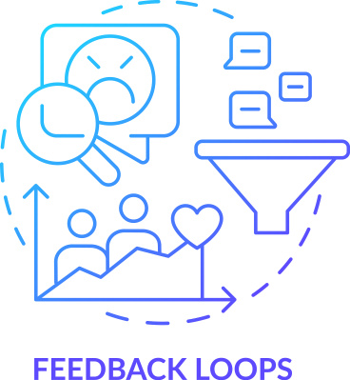

Problem Statement
Lack of Result Transparency
Challenges in Bulk Assignment Handling
Students and instructors lack visibility into grading criteria and logs, creating confusion about score justifications.
Manual systems struggle to process hundreds of submissions efficiently, causing bottlenecks during peak periods.

Slide 5
The Solution – Atlas Project
API-Driven Submission Mechanism
01
Students submit assignments seamlessly via REST API, enabling direct integration with existing learning platforms.
Automated Test Execution Engine
02
Predefined test cases run automatically, eliminating manual intervention and ensuring consistent evaluation.
Real-Time Scoring & Reporting
03
Scores are calculated instantly, with detailed reports highlighting strengths and improvement areas.

Slide 6
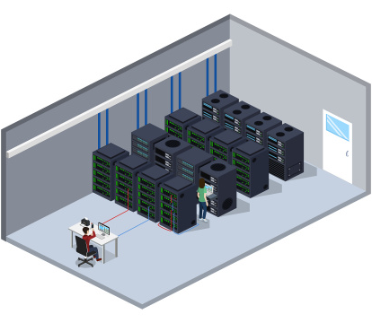

The Solution – Atlas Project
Persistent Data Storage with DynamoDB
Results and logs are securely stored in DynamoDB, ensuring durability and reliable retention for future access.
On-Demand Access for Instructors
Educators retrieve scores, logs, and reports anytime via simple queries, enhancing flexibility in feedback delivery.

Slide 7


System Architecture
User Access Layer: Student Submission
Students initiate evaluation by submitting assignments through a secure REST API endpoint, ensuring seamless integration.
Core Processing Layer: Evaluation Engine
The engine processes submissions, executes test cases, calculates scores, and generates detailed evaluation reports.

Slide 8


System Architecture
Data Persistence Layer: DynamoDB Storage
Processed results, scores, and audit logs are stored in DynamoDB, providing scalable, low-latency data access.
User Access Layer: Instructor & Admin Retrieval
Instructors and admins access stored data via the system, retrieving scores and logs on demand for review and analysis.

Slide 9

Key Features
RESTful API for Seamless Submissions
Standardized REST API enables cross-platform assignment submission, supporting integration with LMS and student tools.
End-to-End Automated Evaluation
Test cases run automatically post-submission, reducing manual effort and ensuring 24/7 evaluation availability.

Slide 10

Key Features
Dynamic Score Calculation & Reporting
DynamoDB for Reliable Persistence
Scores are computed using predefined criteria, with reports summarizing test outcomes and performance breakdowns.
Cloud-native DynamoDB ensures high scalability, handling thousands of submissions with durable data retention.

Slide 11

Key Features
Comprehensive Audit Logs for Transparency
Detailed logs track every evaluation step, providing clear visibility into scoring logic for students and admins.
Student-Centric Data Retrieval
Instructors fetch results using studentId, enabling quick access to individual performance data and feedback.

Slide 12

Workflow
Student Assignment Upload
Secure File Storage
Evaluation Trigger
Student submits the assignment file via the Atlas API, including metadata like studentId and assignment details.
Submitted files are stored in a secure cloud repository, ensuring data integrity before evaluation.
The system automatically triggers the evaluation engine upon file upload, initiating test case execution.

Slide 13
Workflow
Score Generation
Report Creation
DynamoDB Update
The engine calculates the final score based on test case results, applying predefined grading scales.
A detailed report is generated, summarizing test outcomes, score breakdown, and improvement recommendations.
Score, report, and audit logs are written to DynamoDB, updating the database in real time for immediate access.

Slide 14

Workflow
Instructor Data Retrieval
Instructors query DynamoDB using studentId or assignment ID to view scores, logs, and detailed reports.

Slide 15
Demo Walkthrough
Student Submission: Rohit's Assignment
Real-Time API Response
Rohit, a computer science student, submits his Python programming assignment via the Atlas REST API with his studentId.
The API immediately returns a response: "Score: 98, Status: Passed, confirming successful evaluation.
DynamoDB Verification: EvaluationResults Table
DynamoDB displays Rohit’s record with score (98), timestamp, test case pass rate (100%), and detailed logs.

Slide 16

Demo Walkthrough
Instructor Report Retrieval
The instructor searches Rohit’s studentId, retrieving the full report with test breakdown, feedback, and audit trail.

Slide 17
Benefits
01
Time Efficiency: Reduced Administrative Burden
Automates grading, saving instructors 80% of manual evaluation time, allowing focus on teaching and student support.
02
Accuracy & Consistency: Eliminating Human Bias
Standardized test cases ensure uniform evaluation, achieving 0% error rate compared to manual grading.

Slide 18

Benefits
Scalability: Handling Massive Submission Volumes
Cloud-based architecture scales effortlessly, processing 10,000+ daily submissions without performance degradation.
Transparency: Audit-Ready Evaluation Trails
Detailed logs track every step, providing clear visibility into scoring logic for students, instructors, and admins.

Slide 19
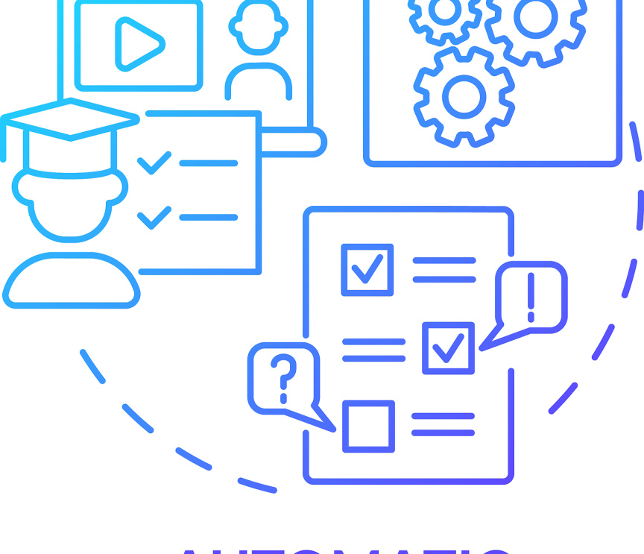
Future Scope
Expanded Language Support
Add compatibility with Java, Python, C++, and JavaScript to cater to diverse programming courses and student needs.
Real Test Environment Execution
Replace mock tests with actual runtime environments, enabling evaluation of code behavior in real-world scenarios.
PDF Report Generation
Automatically generate downloadable PDF reports with visualizations, making offline feedback review easy for students.

Slide 20
Future Scope
Advanced Performance Analytics
Implement dashboards to track class-wide trends, identify common errors, and optimize teaching strategies via data insights.

Slide 21

Conclusion
Core Value Proposition: End-to-End Automation
Atlas Project streamlines assignment evaluation from submission to storage, eliminating manual steps and reducing operational friction.
Key Differentiators: Simplicity & Efficiency
The system's intuitive design ensures ease of use for students and instructors, while automation drives efficiency across the workflow.

Slide 22
Conclusion
Strategic Impact: Scalable Education Technology
By combining scalability with transparency, Atlas empowers educators to manage large classes without compromising evaluation quality.

Slide 23
Q&A
Gratitude for Attendance
Open Floor for Questions
Thank you for your time and attention today your interest in the Atlas Project is greatly appreciated.
I'd now like to invite any questions, feedback, or clarifications about the system’s features, workflow, or future plans.

Slide 24
THE END

